Slide 1

Setting up your optimization problem
Vanishing/exploding
gradients
deeplearning.ai

Slide 2


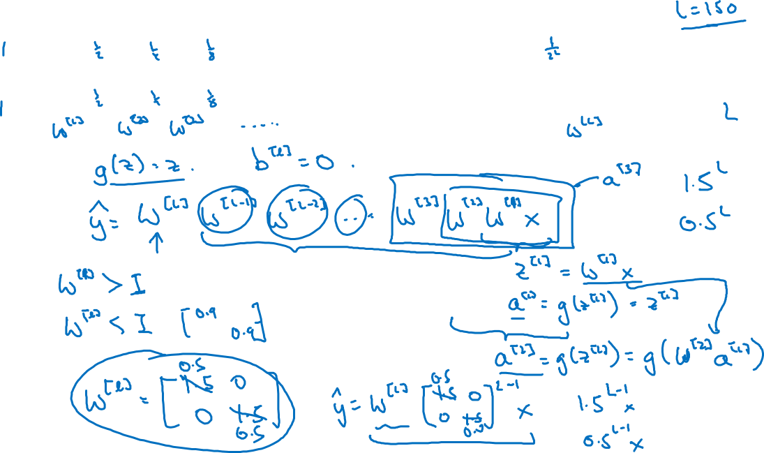

Vanishing/exploding gradients
$x_{1}$
当NN层数很多时，w>I，梯度太大；w<I，梯度太小，需要在初始化时进行调节
$$\hat{y}$$
$x_{2}$
=

Slide 3






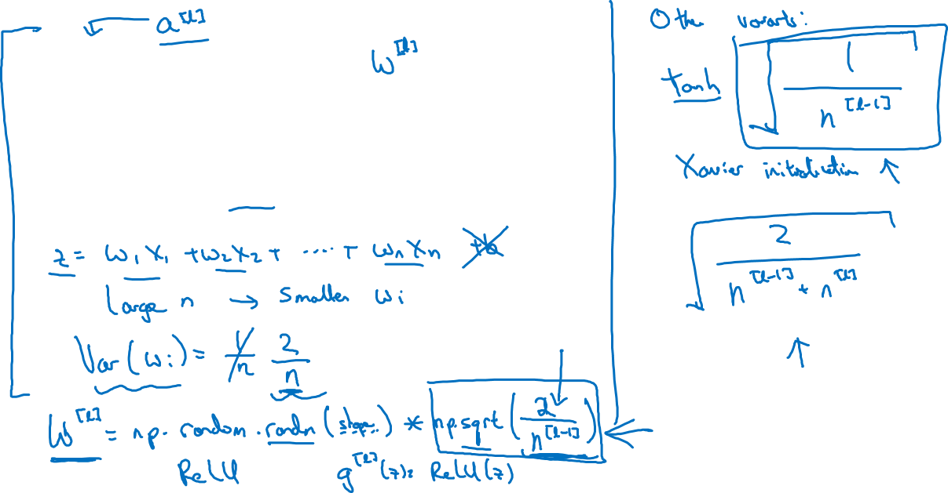
Single neuron example
$x_{1}$
$x_{2}$
$$\hat{y}$$
$x_{3}$
$x_{4}$
$$a=g(z)$$
几种避免梯度太大或太小的初始化方法

